Slide 1
Hack Team
 | Description
Team Name | LTM ShieldOps
Chosen Challenge Statement | Failed Login Pattern Analyzer for Early Threat Detection
Idea Name | AuthGuard — AI-Powered Identity Threat Detection & Response Engine
Problem Statement | Organizations face millions of failed login attempts daily across multiple identity platforms (Entra ID, On-Prem AD, VPN, Web Apps). Security teams lack real-time visibility into attack patterns like brute force, password spray, credential stuffing, and impossible travel. Without automated detection and multi-channel alerting, compromised accounts go unnoticed for hours or days — leading to data breaches, lateral movement, and significant financial and reputational damage.

Slide 2
Solution Build & Submission
Backup your Code repository or relevant files
Our Submission Package (Team LTM ShieldOps):
Final PPT — Solution overview, architecture & approach
Demo Video (~10 min) — End-to-end live walkthrough
Code Repository — Python simulator, Azure Function, KQL queries, Logic App JSON, Adaptive Card template
Screenshots — Dashboard, Alerts, Sentinel, Incidents
README — Setup guide & documentation

Slide 3
Technical Architecture
AuthGuard Architecture
 | Description
Architecture Overview | AuthGuard — Cloud-native identity threat detection engine, 6-Stage Automated Pipeline: SIMULATE → Python generates 7 attack types → Log Analytics DETECT → 8 KQL rules identify threat patterns in real-time ENRICH → Azure Function adds IP reputation + risk score (0-100) ORCHESTRATE → Logic App automates every 30 min ALERT → Teams | Email | SMS | Sentinel | Azure Monitor VISUALIZE → Workbook Dashboard (15+ tiles) | Power BI | Incident Log
Core Components (Microsoft Technology / Services Touched) | Log Analytics Workspace — Central log store + KQL engine Azure Functions — Serverless threat enrichment (Python) Logic Apps — Automated orchestration pipeline Microsoft Sentinel — SIEM + 4 detection rules Defender XDR — Unified security portal Azure Monitor — Native alerting (Email + SMS) Azure Workbooks — Interactive security dashboard Table Storage — Incident audit trail (200+ records) MS Teams + Outlook + SMS — Multi-channel alerting Power BI — Executive reporting MITRE ATT&CK — T1110, T1078 mapping ARM Templates — Infrastructure-as-Code
Security & Compliance | Entra ID + RBAC authentication TLS 1.2+ encryption (transit) + Azure Storage encryption HMAC-SHA256 API authentication NIST Cybersecurity Framework aligned SOC 2 audit trail via incident logging Budget — Total cost: $0.41/$55
Python Simulator
7 Attack Scenarios
(Cloud Shell)
Log Analytics Workspace - 8 KQL Rules
Azure Function (IP Reputation Risk Scoring)
Logic App
MS Teams, Email, SMS, Sentinel, Incident Log - Alerts
Workbook Dashboard
Power BI

Slide 4
Solution Approach
 | Description
Relevance to Challenge (20 Points) | 7 attack scenarios simulated (vs. typical 2-3) • 8 KQL detection rules with real-time pattern analysis Complete pipeline: Detection → Enrichment → Alert → Log) • Multi-channel SOC alerting (Teams, Email, SMS, Sentinel) MITRE ATT&CK mapped (T1110 Brute Force, T1078 Valid Accounts)
Innovation & Creativity (10 Points) | Impossible Travel Detection — Haversine geo-distance calculation (e.g., Pune → Moscow in 5 min = 54,000 km/h → IMPOSSIBLE) Composite Risk Score (0-100) — 5 weighted signals • IP Reputation Engine — TOR nodes, Botnet C2, Known Scanners Proactive Threat Hunting via Sentinel hunting queries
Technical Implementation (10 Points) | 15+ Azure services integrated end-to-end • Serverless architecture (Functions + Logic Apps) 4 Sentinel analytics rules + 1 custom detection rule • ARM template for one-click repeatable deployment Pipeline: Simulate → Detect → Enrich → Alert → Log
User Experience (15 Points) | SOC Dashboard — Workbook with 15+ interactive tiles • MS Teams — Adaptive Cards with actions + recommendations Email — HTML formatted, IST timestamps, color-coded • SMS — Instant mobile alerts for critical threats Power BI — Executive reporting with drill-down • Audit — Incident log (200+ auto-logged records)
Impact & Scalability (15 Points) | Detection in 5-30 min (vs. hours/days manually) • Simultaneous alert channels Cost: $0.41 / $55 budget (0.75% used!) • Serverless = auto-scales with demand ARM template = deploy to any Azure tenant • Connects to real Entra ID sign-in logs for production
Presentation & Pitch (10 Points) | Structure: Problem → Solution → Demo → Impact → Roadmap • $4.88M avg breach cost (IBM 2024) — early detection prevents 80% Working end-to-end solution — not a concept
Adaptability & Flexibility (10 Points) | Swap data source: Entra ID, AWS CloudTrail, GCP Identity • Cross-industry: Healthcare (HIPAA), Finance (PCI-DSS), Govt Add attacks: MFA fatigue, session hijacking, token theft • Auto-remediation: Conditional Access IP blocking Configurable thresholds — no code changes needed
Overall Impression (10 Points) | Enterprise-grade identity threat detection engine • 15+ Azure services in one cohesive pipeline 7 attack types | 5 alert channels | 15+ dashboard tiles • Sentinel SIEM + MITRE ATT&CK integration Total cost: $0.41 — exceptional cost efficiency
Why does your POC/Tool worthy of GTM development ? | 80% of breaches = compromised credentials (Verizon DBIR 2024) • Identity threat market growing 14.2% CAGR Path: Connect real Entra ID → Add auto-remediation → ML-based adaptive thresholds → Azure Marketplace packaging GTM timeline: 3-6 months from POC to MVP

Slide 5
Demo Video & Pitch Best Practices
Our Demo Video Structure (Team LTM ShieldOps):
Introduction & Problem Statement "Organizations face millions of failed logins daily...“
Live Attack Simulation Run 7 attack scenarios in Azure Cloud Shell Show data flowing into Log Analytics
Detection & Dashboard KQL detection engine identifies threats Walkthrough 15+ tile security dashboard
Multi-Channel Alerting (LIVE!) Teams Adaptive Card → SOC channel HTML Email Alert → Outlook (IST time) SMS Alert → Mobile phone
Enrichment & SIEM Azure Function → IP reputation + risk scoring Microsoft Sentinel → Incidents + MITRE ATT&CK
Business Impact Cost: $0.41 / $55 (0.75% budget) 5 alert channels | 7 attack types | 15+ tiles
Future Roadmap & GTM Real Entra ID → Auto-remediation → ML thresholds → Azure Marketplace (3-6 month timeline)

Slide 6
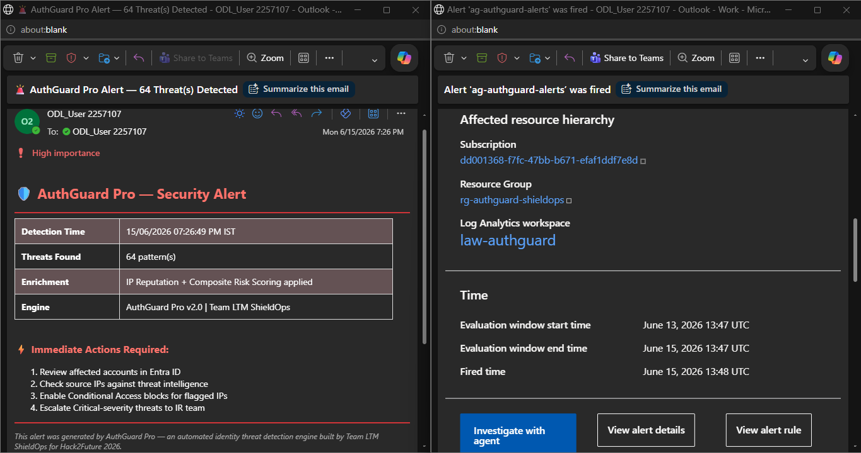
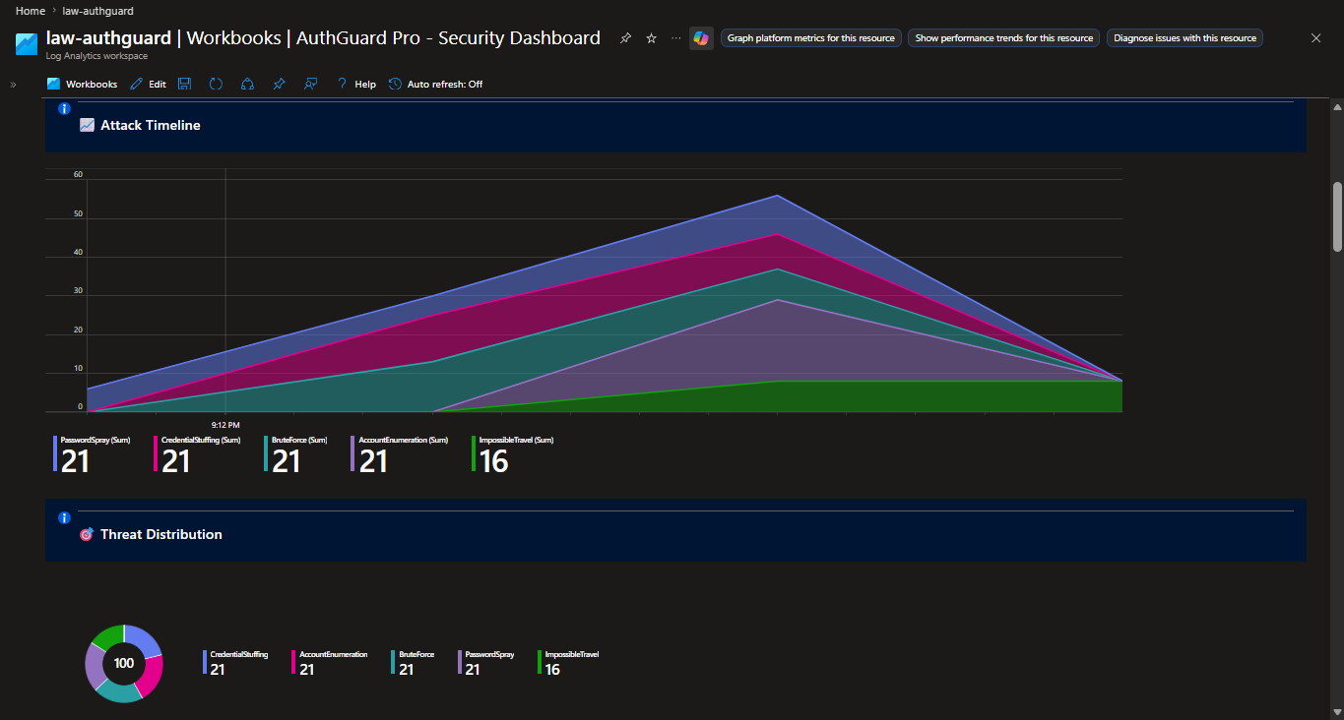
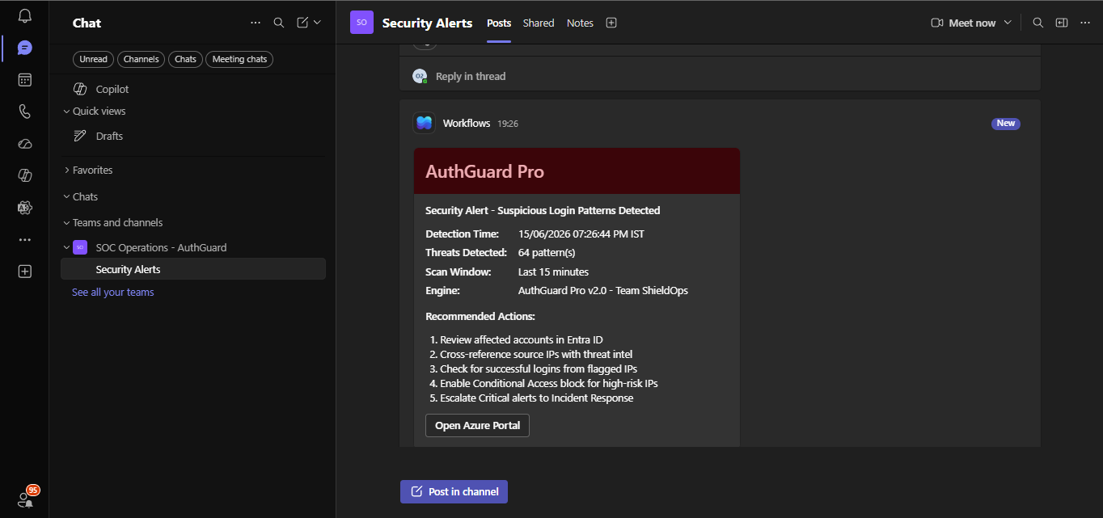
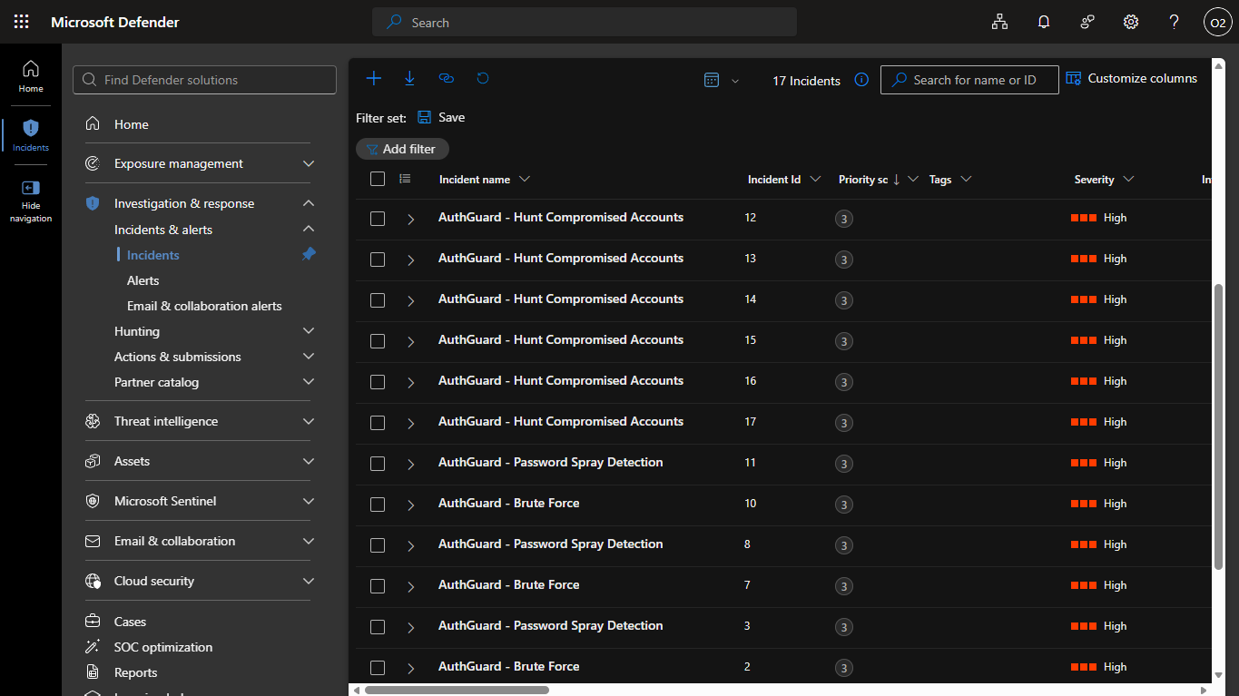
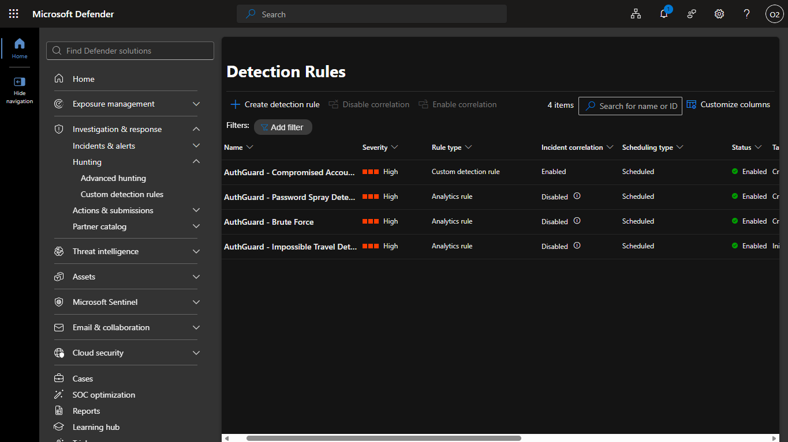
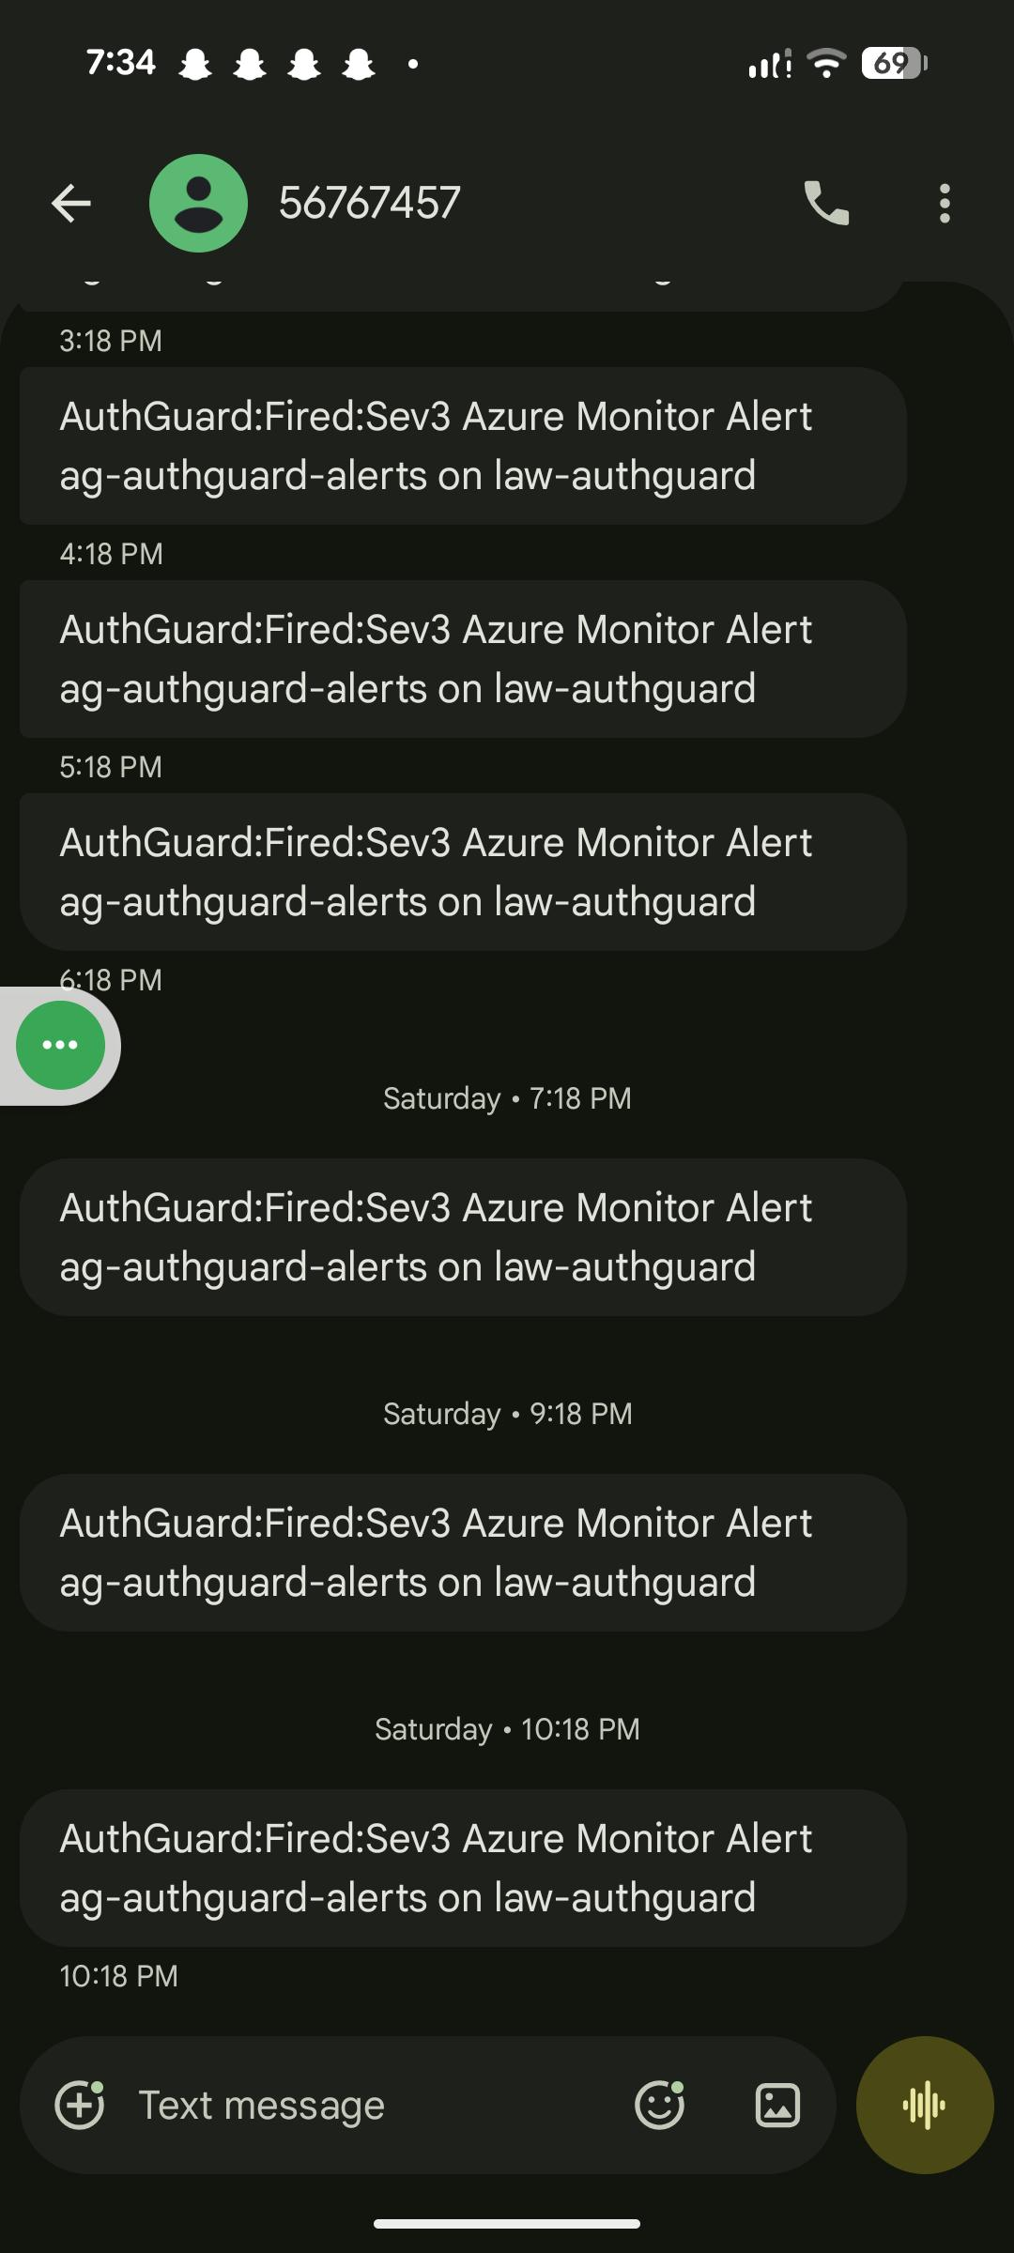
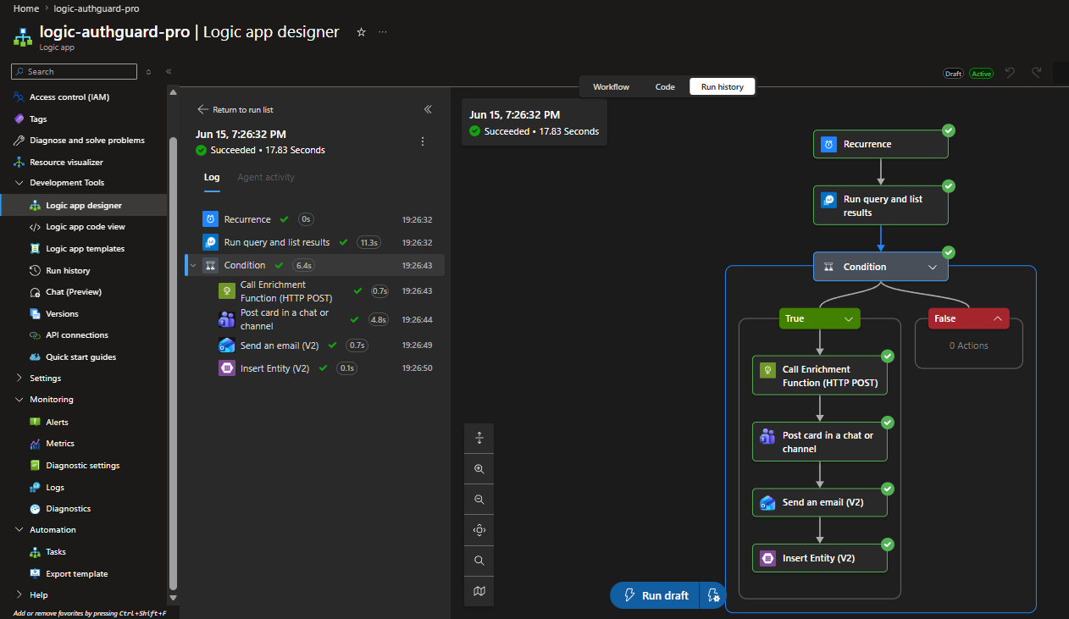
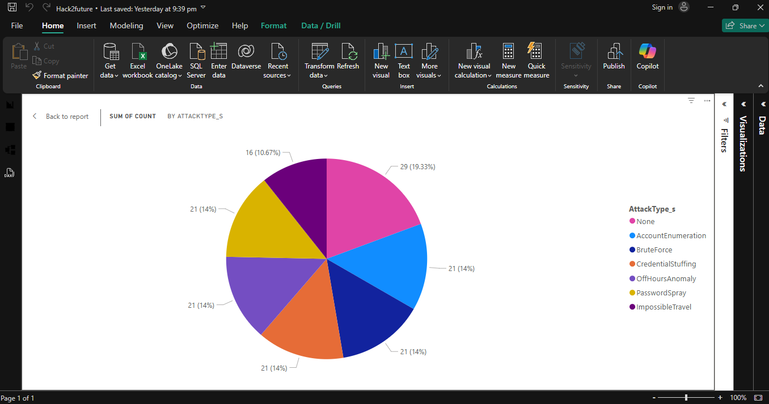
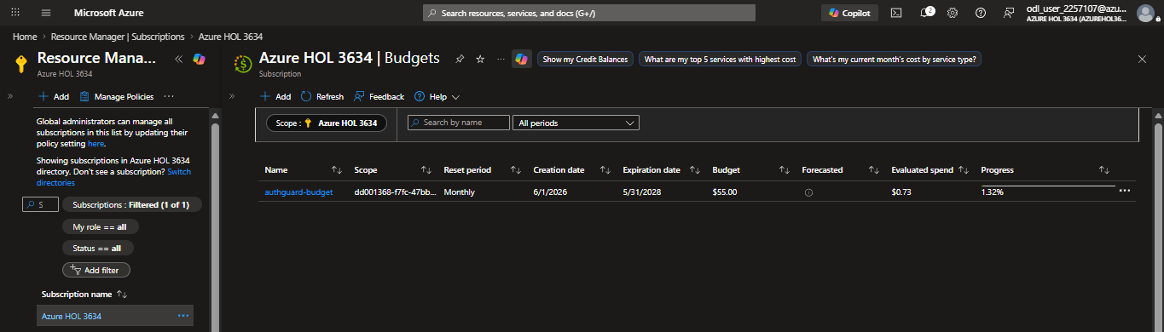
References/Screenshots
Notes:
Screenshots :
Row 1: Security Dashboard | Teams SOC Alert | Email Alert (HTML) | Row 2: SMS Mobile Alert | Sentinel Incidents | Detection Rules |
Row 3: Logic App Workflow | Power BI Report | Cost: $0.41/$55 |

